Slide 1
From Bayesian Filtering to
Particle Filters
Dieter Fox
University of Washington
Joint work with
W. Burgard, F. Dellaert, C. Kwok, S. Thrun

Slide 2
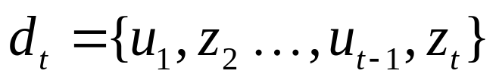
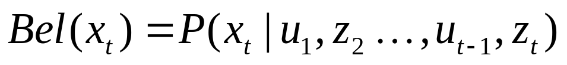
Bayes Filters: Framework
Given:
  Stream of observations z and action data u:
  Sensor model P(z|x).
  Action model P(x|u,x’).
  Prior probability of the system state P(x).
Wanted:
  Estimate of the state X of a dynamical system.
  The posterior of the state is also called Belief:

Slide 3
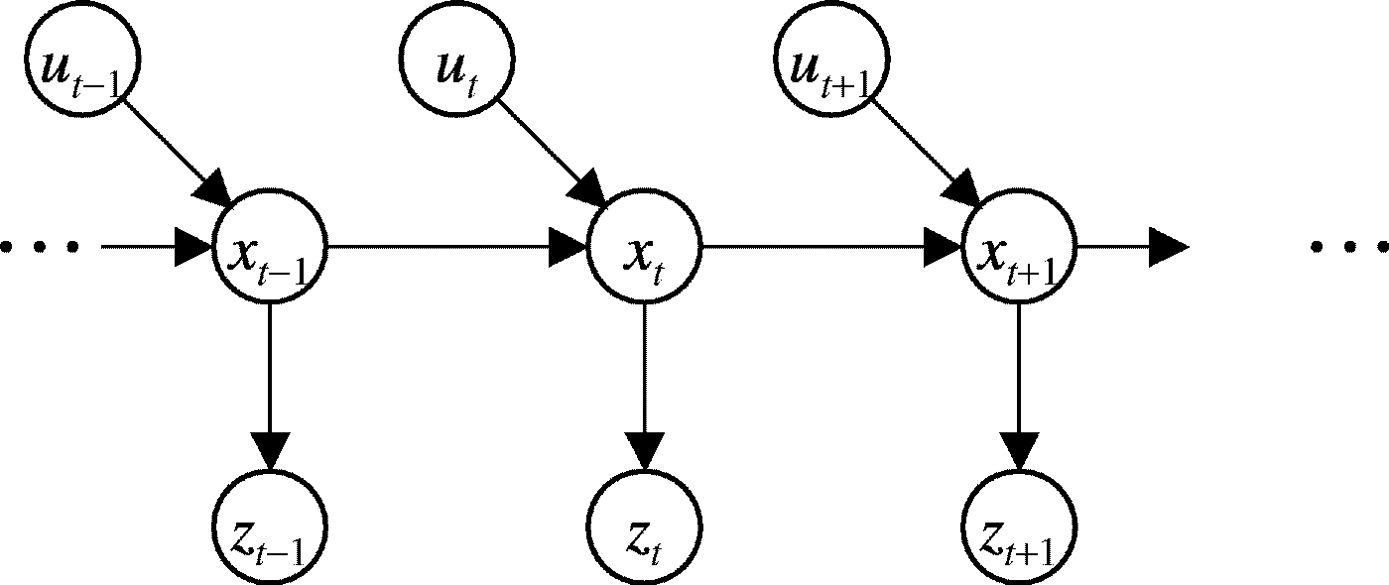
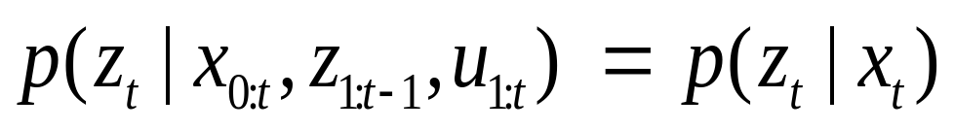
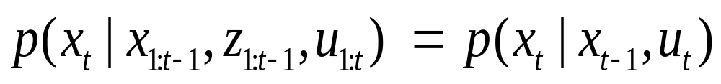
Graphical Model Representation
Underlying Assumptions
Static world
Independent noise
Perfect model, no approximation errors

Slide 4
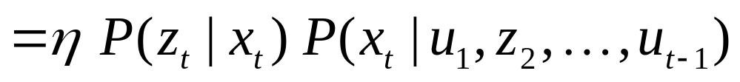
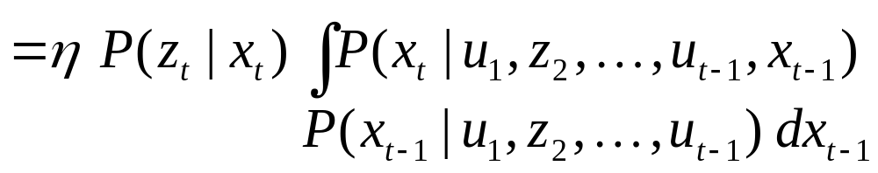
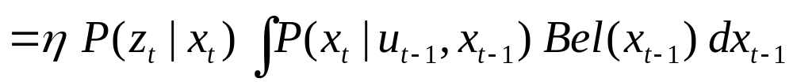
Bayes Filters
z = observation
u = action
x = state
Bayes
Markov
Total prob.
Markov

Slide 5
Bayes Filters are Familiar!
Kalman filters (linear, extended, unscented)
Particle filters (Rao-Blackwellized)
Hidden Markov models
Dynamic Bayesian networks
Estimator in Partially Observable Markov Decision Processes (POMDPs)

Slide 6
Robot Localization
“Using sensory information to locate the robot in its environment is the most fundamental problem to providing a mobile robot with autonomous capabilities.” [Cox ’91]
Given
  Map of the environment.
  Sequence of sensor measurements.
Wanted
  Estimate of the robot’s position.
Problem classes
  Position tracking
  Global localization
  Kidnapped robot problem (recovery)

Slide 7
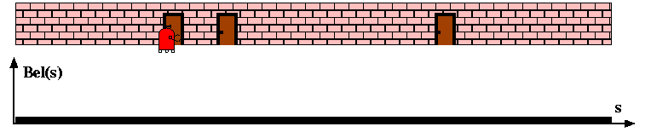
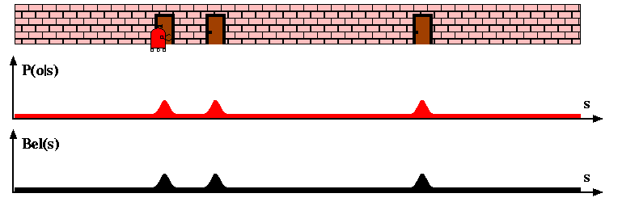
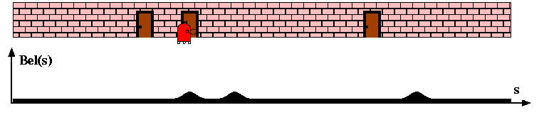
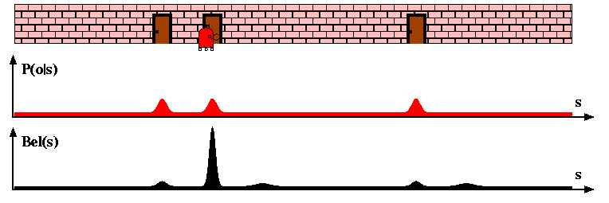
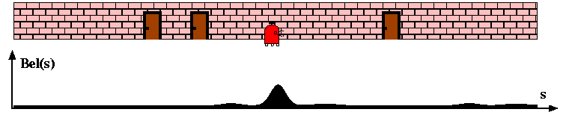
Bayes Filters for Robot Localization

Slide 8
Representations for Bayesian Robot Localization
Kalman filters (late-80s)
Gaussians
approximately linear models
position tracking
Discrete approaches (’95)
Topological representation (’95)
  uncertainty handling (POMDPs)
  occas. global localization, recovery
Grid-based, metric representation (’96)
  global localization, recovery
Continuous
Discrete
Particle filters (’99)
sample-based representation
global localization, recovery
Multi-hypothesis (’00)
multiple Kalman filters
global localization, recovery

Slide 9
Particle Filters

Slide 10
Particle Filters
Represent belief by random samples
Estimation of non-Gaussian, nonlinear processes
Monte Carlo filter, Survival of the fittest, Condensation, Bootstrap filter, Particle filter
Filtering: [Rubin, 88], [Gordon et al., 93], [Kitagawa 96]
Computer vision: [Isard and Blake 96, 98]
Dynamic Bayesian Networks: [Kanazawa et al., 95]

Slide 11
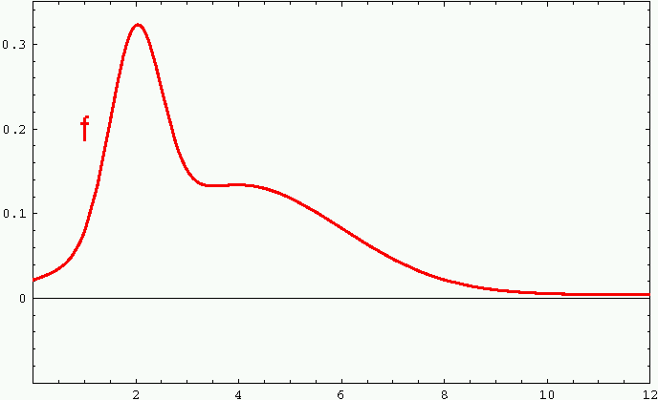
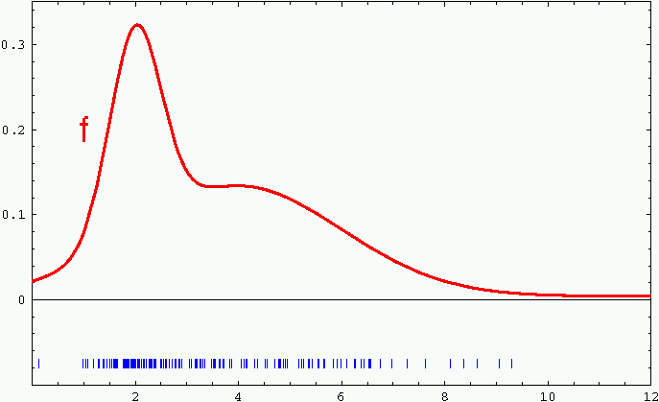
Sample-based Representation

Slide 12
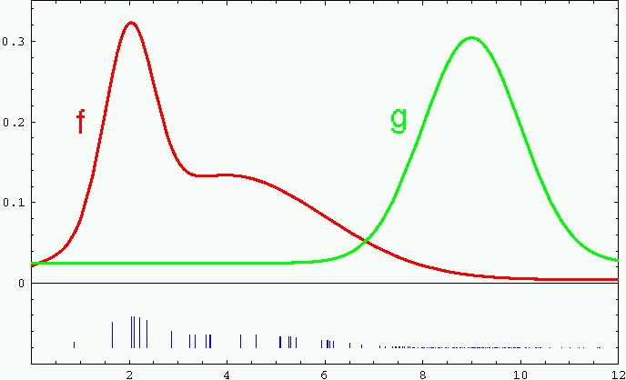
Importance Sampling
Weight samples: w = f / g

Slide 13
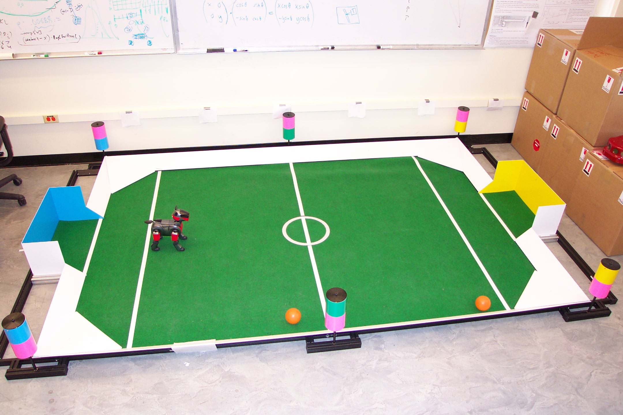
Importance Sampling with Resampling:
Landmark Detection Example

Slide 14
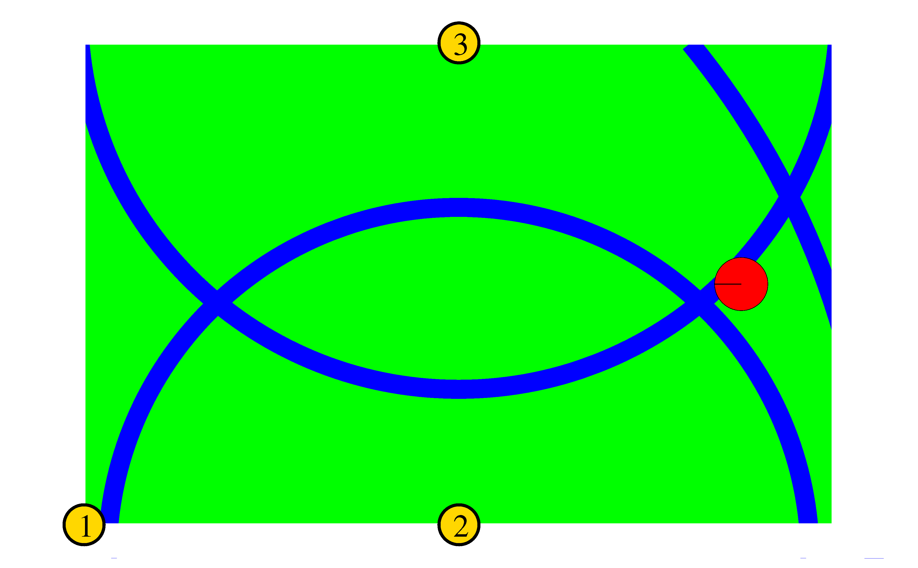
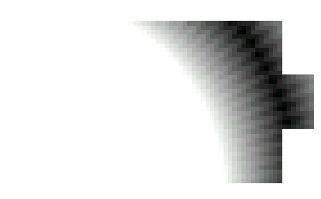
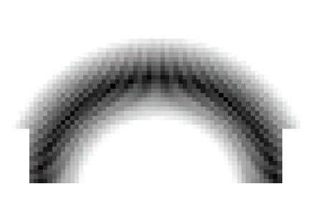
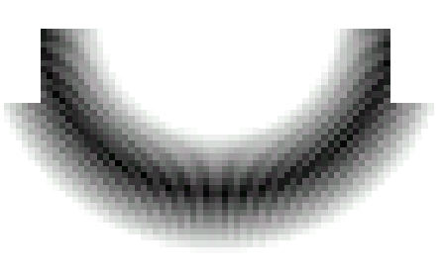
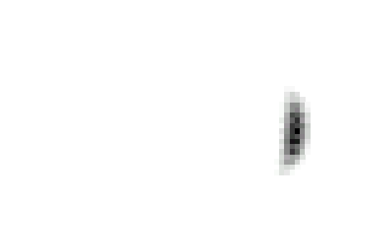
Distributions

Slide 15
Distributions
Wanted: samples distributed according to p(x| z₁, z₂, z₃)

Slide 16
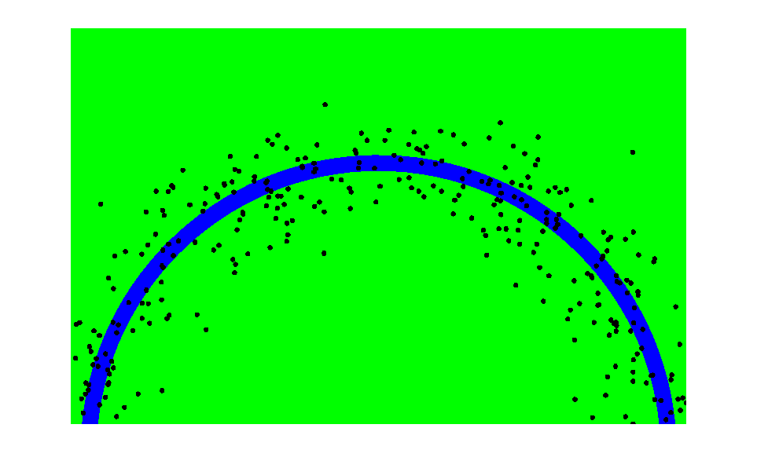
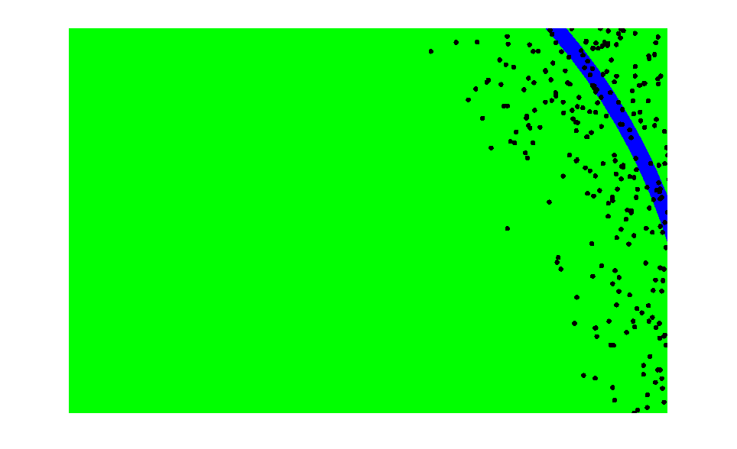
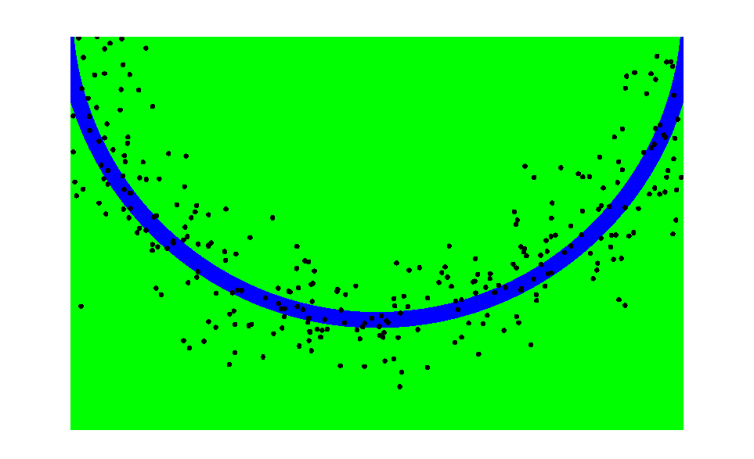
This is Easy!
We can draw samples from p(x|z_{l}) by adding noise to the detection parameters.

Slide 17
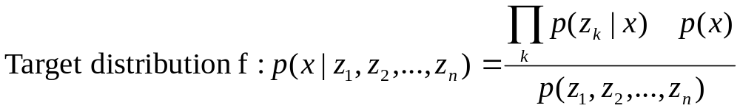
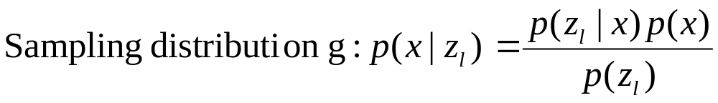
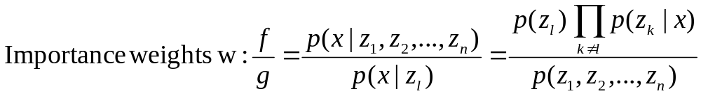
Importance Sampling with Resampling

Slide 18
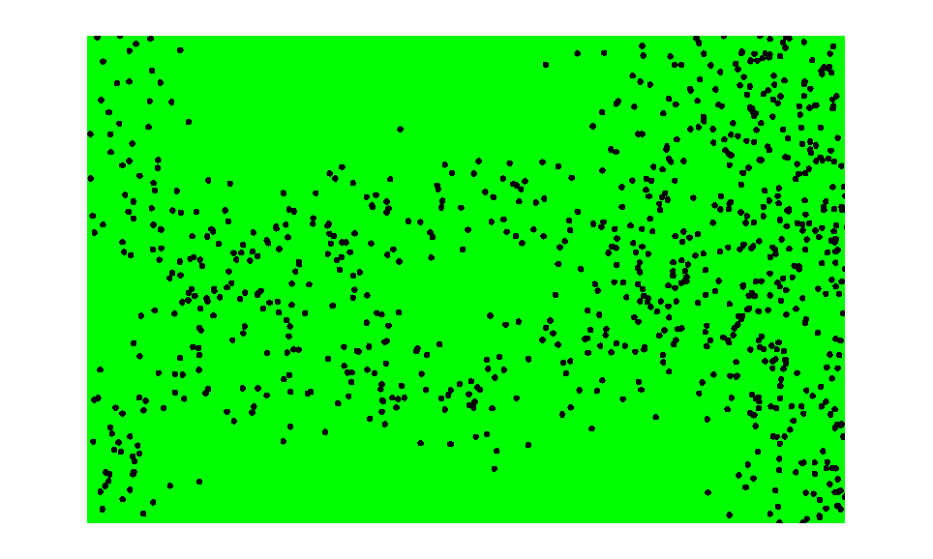
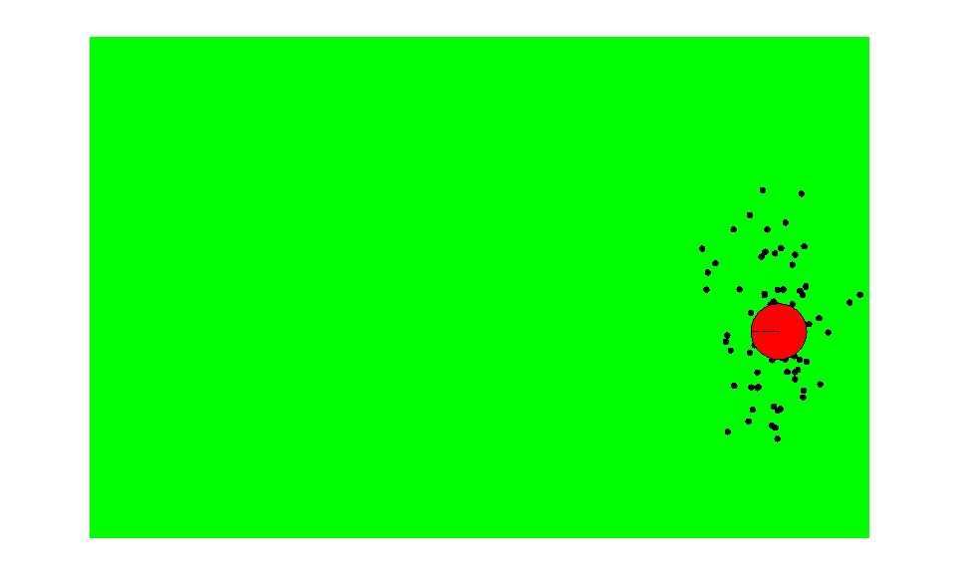
Importance Sampling with Resampling
Weighted samples
After resampling

Slide 19
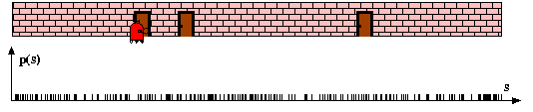
Particle Filters

Slide 20
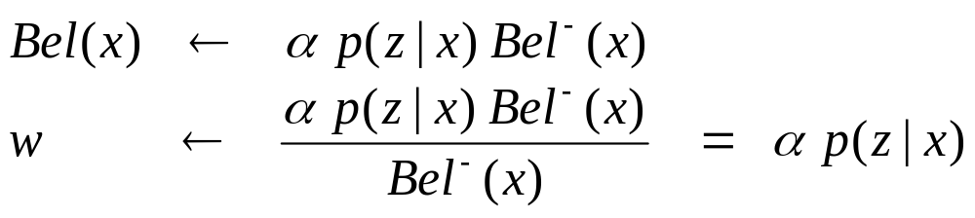
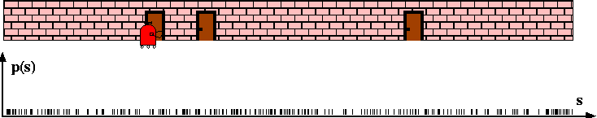
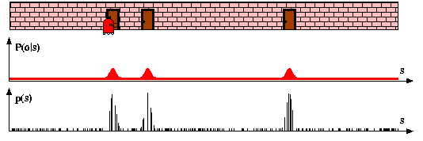
Sensor Information: Importance Sampling

Slide 21
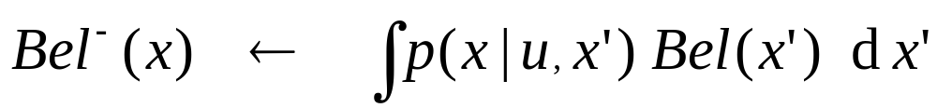
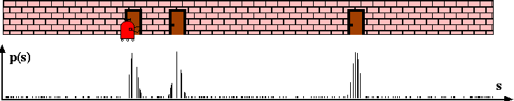
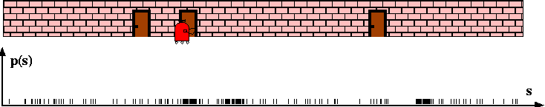
Robot Motion

Slide 22
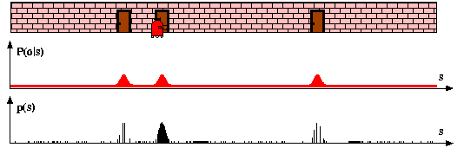
Sensor Information: Importance Sampling

Slide 23
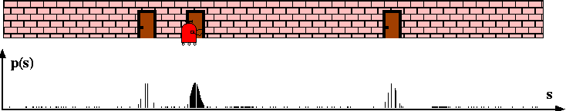
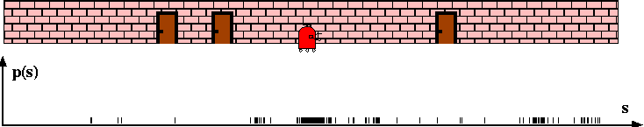
Robot Motion

Slide 24
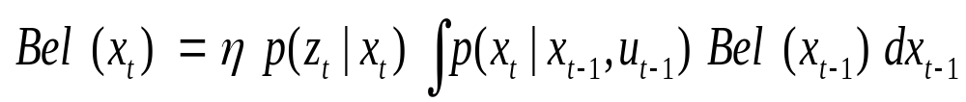
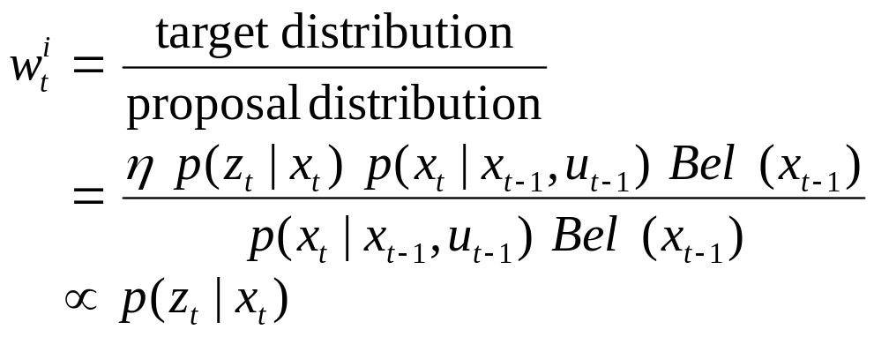
Particle Filter Algorithm
draw x^{i}_{t−1} from Bel(x_{t−1})
draw x^{i}_{t} from p(x_{t} | x^{i}_{t−1},u_{t−1})
Importance factor for x^{i}_{t}:

Slide 25
Resampling
Given: Set S of weighted samples.
Wanted : Random sample, where the probability of drawing x_{i} is given by w_{i}.
Typically done n times with replacement to generate new sample set S’.

Slide 26
Resampling
w_{n}
w₁
w_{n}
w₁
w₂
w₂
W_{n-1}
W_{n-1}
w₃
w₃
Stochastic universal sampling
Systematic resampling
Linear time complexity
Easy to implement, low variance
Roulette wheel
Binary search, n log n

Slide 27
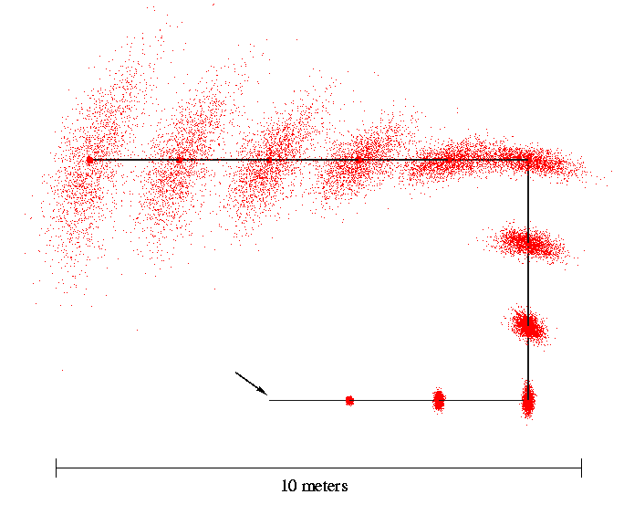
Motion Model Example
Start

Slide 28
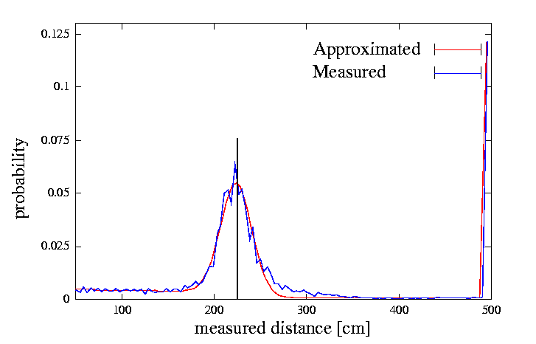
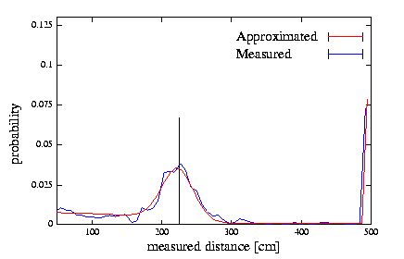
Proximity Sensor Model Example
Laser sensor
Sonar sensor

Slide 29
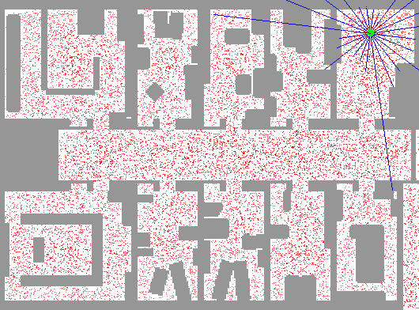
Sample-based Localization (sonar)

Slide 30
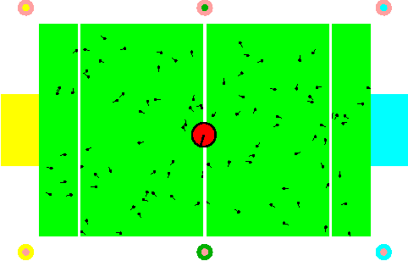
Localization for AIBO robots

Slide 31
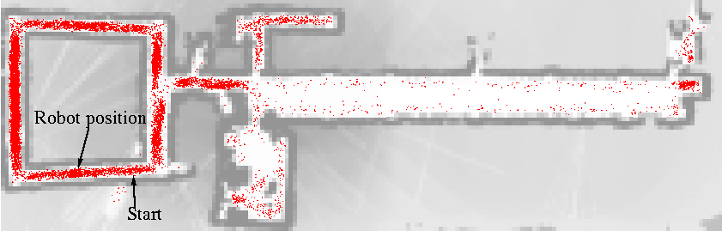
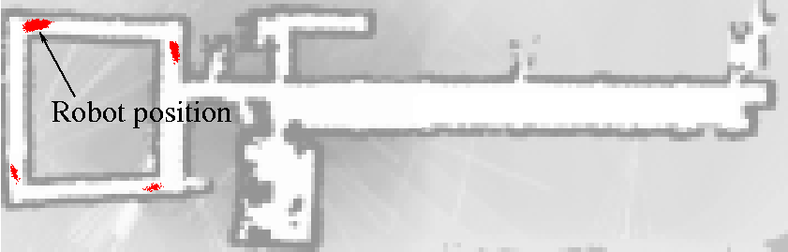
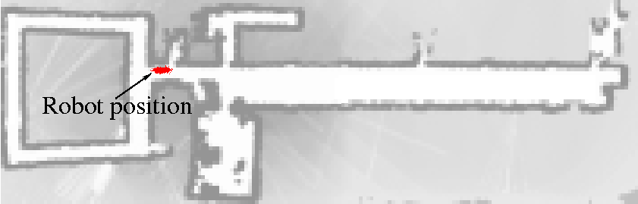
How Many Samples?

Slide 32

KLD-sampling
Idea:
  Assume we know the true belief.
  Represent this belief as a multinomial distribution.
  Determine number of samples such that we can guarantee that, with probability (1- δ), the KL-distance between the true posterior and the sample-based approximation is less than ε.
Observation:
  For fixed δ and ε, number of samples only depends on number k of bins with support:
[Fox NIPS-01, Fox IJRR-03]

Slide 33


Evaluation

Slide 34

KLD-Sampling: Sonar
[Fox NIPS-01, Fox IJRR-03]

Slide 35

KLD-Sampling: Laser

Slide 36
Practical Considerations
Dealing with highly peaked observations
  Add noise to observation model
  Better proposal distributions: e.g., perform Kalman filter step to determine proposal
Recover from failure by selectively adding samples from observations
Overestimating noise often reduces number of required samples
Resample only when necessary (efficiency of representation measured by variance of weights)
Try to avoid sampling whenever possible!

Slide 37
Rao-Blackwellised Particle Filter Example

Slide 38

Ball Tracking in RoboCup
Extremely noisy (nonlinear) motion of observer
Inaccurate sensing, limited processing power
Interactions between target and environment
Interactions between robot(s) and target
Goal: Unified framework for modeling the ball and its interactions.

Slide 39
Tracking Techniques
Kalman Filter
  Highly efficient, robust (even for nonlinear)
  Uni-modal, limited handling of nonlinearities
Particle Filter
  Less efficient, highly robust
  Multi-modal, nonlinear, non-Gaussian
Rao-Blackwellised Particle Filter, MHT
  Combines PF with KF
  Multi-modal, highly efficient

Slide 40
Dynamic Bayesian Network for Ball Tracking
z
l
z
l
z
l
Landmark detection
k-2
k-1
k
Robot localization
r
k-2
r
k-1
r
k
Map and robot location
u
k-2
u
k-1
Robot control
m
k-2
m
k-1
m
k
Ball motion mode
b
k-2
b
k-1
b
k
Ball location and velocity
Ball tracking
z
b
z
b
z
b
Ball observation
k-2
k-1
k

Slide 41
Robot Location
z
l
z
l
z
l
Landmark detection
k-2
k-1
k
Robot localization
r
k-2
r
k-1
r
k
Map and robot location
u
k-2
u
k-1
Robot control
m
k-2
m
k-1
m
k
Ball motion mode
b
k-2
b
k-1
b
k
Ball location and velocity
Ball tracking
z
b
z
b
z
b
Ball observation
k-2
k-1
k

Slide 42
Robot and Ball Location (and velocity)
z
l
z
l
z
l
Landmark detection
k-2
k-1
k
Robot localization
r
k-2
r
k-1
r
k
Map and robot location
u
k-2
u
k-1
Robot control
m
k-2
m
k-1
m
k
Ball motion mode
b
k-2
b
k-1
b
k
Ball location and velocity
Ball tracking
z
b
z
b
z
b
Ball observation
k-2
k-1
k

Slide 43
Ball-Environment Interactions
(
0
.
8
)
(
residual prob
.)
Robot loses grab
(
0
.
2
)
None
Within grab range
Grabbed
h
and robot grabs
t
i
w
)
(
prob
.
from model
)
s
0
n
t
.
R
o
c
1
i
e
(
)
b
o
s
j
p
0
(
a
b
i
b
a
)
)
.
1
l
.
l
o
l
o
m
0
1
1
0
)
l
t
o
.
.
(
(
C
1
0
0
k
n
(
(
Kick fails
(
0
.
1
)
.
i
o
9
c
)
k
s
Bounced
Deflected
Kicked

Slide 44
Integrating Discrete Ball Motion Mode
z
l
z
l
z
l
Landmark detection
k-2
k-1
k
Robot localization
r
k-2
r
k-1
r
k
Map and robot location
u
k-2
u
k-1
Robot control
m
k-2
m
k-1
m
k
Ball motion mode
b
k-2
b
k-1
b
k
Ball location and velocity
Ball tracking
z
b
z
b
z
b
Ball observation
k-2
k-1
k

Slide 45
Grab Example (1)
z
l
z
l
z
l
Landmark detection
k-2
k-1
k
Robot localization
r
k-2
r
k-1
r
k
Map and robot location
u
k-2
u
k-1
Robot control
m
k-2
m
k-1
m
k
Ball motion mode
b
k-2
b
k-1
b
k
Ball location and velocity
Ball tracking
z
b
z
b
z
b
Ball observation
k-2
k-1
k

Slide 46
Grab Example (2)
z
l
z
l
z
l
Landmark detection
k-2
k-1
k
Robot localization
r
k-2
r
k-1
r
k
Map and robot location
u
k-2
u
k-1
Robot control
m
k-2
m
k-1
m
k
Ball motion mode
b
k-2
b
k-1
b
k
Ball location and velocity
Ball tracking
z
b
z
b
z
b
Ball observation
k-2
k-1
k

Slide 47

Inference: Posterior Estimation
z
l
z
l
z
l
Landmark detection
k-2
k-1
k
Robot localization
r
k-2
r
k-1
r
k
Map and robot location
u
k-2
u
k-1
Robot control
m
k-2
m
k-1
m
k
Ball motion mode
b
k-2
b
k-1
b
k
Ball location and velocity
Ball tracking
z
b
z
b
z
b
Ball observation
k-2
k-1
k

Slide 48
Particle Filter for Robot Localization

Slide 49

Rao-Blackwellised PF for Inference
Factorize state space into different components
Represent some part(s) by samples and remaining part analytically, conditioned on samples
Each sample
contains robot location, ball mode, ball location

Slide 50

Rao-Blackwellised Particle Filter for Inference
Robot localization
r
k-1
r
k
Map and robot location
m
k-1
m
k
Ball motion mode
b
k-1
b
k
Ball location and velocity
Ball tracking
Draw a sample from the previous sample set:

Slide 51
Generate Robot Location
z
l
Landmark detection
k
Robot localization
r
k-1
r
k
Map and robot location
u
k-1
Robot control
m
k-1
m
k
Ball motion mode
b
k-1
b
k
Ball location and velocity
Ball tracking

Slide 52
Generate Ball Motion Model
z
l
Landmark detection
k
Robot localization
r
k-1
r
k
Map and robot location
u
k-1
Robot control
m
k-1
m
k
Ball motion mode
b
k-1
b
k
Ball location and velocity
Ball tracking

Slide 53
Update Ball Location and Velocity
z
l
Landmark detection
k
Robot localization
r
k-1
r
k
Map and robot location
u
k-1
Robot control
m
k-1
m
k
Ball motion mode
b
k-1
b
k
Ball location and velocity
Ball tracking
z
b
k

Slide 54


Importance Resampling
Weight sample by
if observation is landmark detection and by
if observation is ball detection.
Resample

Slide 55




Ball-Environment Interaction

Slide 56


Ball-Environment Interaction

Slide 57


Tracking and Finding the Ball
Cluster ball samples by discretizing
pan / tilt angles
Uses negative information

Slide 58
Experiment: Real Robot
Robot kicks ball 100 times, tries to find it afterwards
Finds ball in 1.5 seconds on average
0.5
With Map
0.45
Without Map
0.4
0.35
0.3
Percentage of ball lost
0.25
0.2
0.15
0.1
0.05
0
0
5
10
15
20
25
30
35
40
45
50
Number of ball samples

Slide 59
Error vs. Prediction Time
80
RBPF
70
KF'
KF*
60
50
RMS Error [cm]
40
30
20
10
0
0
0.5
1
1.5
2
Prediction time [sec]

Slide 60

Simulation Runs
Reference
* Observations

Slide 61
Comparison to KF* (optimized for straight motion)
RBPF
KF*
Reference
* Observations

Slide 62
Comparison to KF’ (inflated prediction noise)
RBPF
KF’
Reference
* Observations

Slide 63
Orientation Errors
180
RBPF
160
KF*
KF'
140
120
100
Orientation Error [degrees]
80
60
40
20
0
2
3
4
5
6
7
8
9
10
11
Time [sec]

Slide 64
Discussion
Particle filters are intuitive and “simple”
  Support point-wise thinking (reduced uncertainty)
  It’s an art to make them work
  Good for test implementation if system behavior is not well known
Inefficient compared to Kalman filters
Rao-Blackwellization for complex problems
  Only sample discrete / highly non-linear parts of state space
  Solve remaining part analytically (KF,discrete)

